Slide 1
More About Debate
<Coach Name>

Slide 2
Quick review!
What are the 3 main parts of an argument?
To practice, can you provide these 3 parts for the argument: “Apple is better than Samsung.”
Notes:
Focus on claim, warrant, and impact with your students.

Slide 3
01 YFD Debate Format
Last class we introduced the general structure of a debate, but today we will introduce the Youth for Debate format.

Slide 4
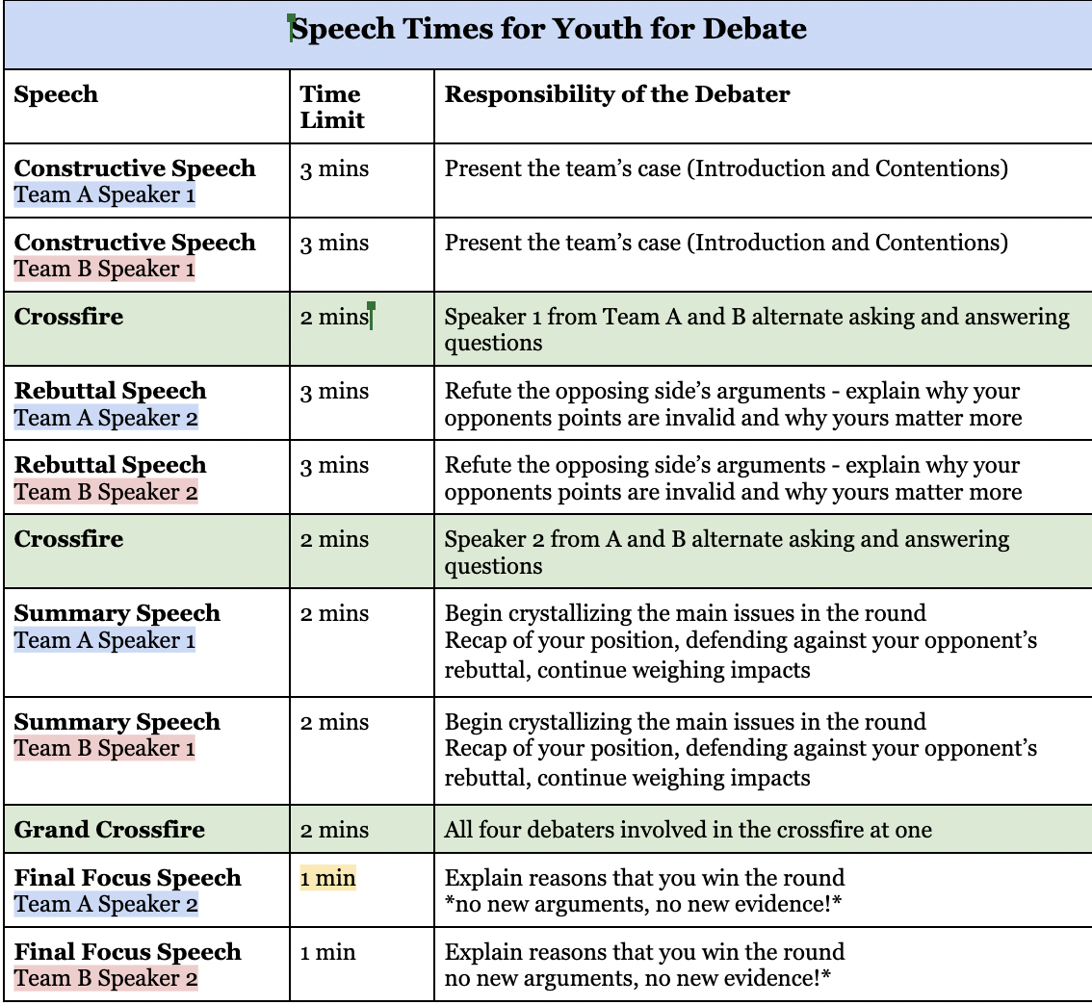
Our debate format
Notes:
Walk through each speech, its purpose, its length, and what should happen during the speech. Try to spend at least 5 minutes on this so debaters can soak in the information.

Slide 5
02 Expanding on Crossfire
Last time we introduced crossfire, and today we will dive more into the details.

Slide 6
What types of questions should you ask in crossfire?
CLARIFICATION
Was there something confusing in their case? If you could clarify what they mean, it might help you to make stronger arguments against them later….
EVIDENCE
QUALITY
Who wrote their evidence? What is the date? Is this source TIMELY? Is this author biased? Are they qualified?
POKING HOLES
Set up your later speeches by asking questions you can exploit in your later speeches. It is especially good to point out contradictions and logical inconsistencies in the case if you find them.
Notes:
Note that clarification should be a debater’s first priority. Although asking questions about evidence quality and poking holes in the case can be strategically advantageous, debaters should prioritize understand the case first. It’s hard to debate a case if you don’t even understand parts of it!

Slide 7
When does crossfire happen in our debate?
Crossfire happens in the green highlighted sections!

Slide 8
Example: you try!
Your opponents read a piece of evidence that 900 million people will enter extreme poverty in the event of a global recession.
What can you ask them to point out the problems with this argument?

Slide 9
Example questions to ask
Why didn’t we see this during the COVID-recession of 2020? Or the recession of 2008?
How can we know with any accuracy that this is the correct number?
How did the author(s) reach this number?

Slide 10
Answering crossfire questions
Dos
Actually answer the question, if possible–dodging the question makes you seem unsure or unconfident.
Keep your answers short and sweet.
Reference your evidence. Not only will this help you answer questions effectively, but this also shows the judge that you know your speech inside and out, which boosts speaker points.
Donts
Don’t be afraid to admit you don't know something. If your opponent asks you something that both you and your partner don't know, it's better to admit you don't know than to lie about it. You can always argue later that it's not an important element of the debate anyways.
Answer irrelevant questions.

Slide 11
03 Impact Weighing
This will be very important throughout all the speeches of the round!

Slide 12
Weighing is a way of comparing impacts!
Usually, both teams win some part of their arguments... but weighing is how you make sure yours matter (weigh) more so that you win the round!
Notes:
In other words, weighing is how you “prove” that your arguments are the most important in the round.

Slide 13
Common ways to weigh impacts
Probability
My argument is more probable/more likely to happen than my opponent’s for x reason.
Magnitude
How severe is the impact? For example, a global plague is more severe than a person falling and scraping their knee.
Timeframe
Does your impact happen today? Does my impact happen in 20 years? Does your impact last for a decade? Does mine last for 2 minutes? Short term vs. long term time frame evaluation!
Reversibility
Can your impact be reversed? For example, impacts like climate change or a nuclear bomb detonating cannot be “reversed”-- their effects cannot be undone.

Slide 14
Let’s practice with Weighing Wars!

Slide 15
Weighing Practice
Some common impacts…
Income Inequality vs. Global Warming
Economic Decline vs. Environmental Disaster
Disease Spread vs. Democracy Decline
Practice weighing on PROBABILITY, MAGNITUDE, TIMEFRAME, and REVERSIBILITY!
Notes:
Either do the practice as a group and ask for volunteers to explain how they would weigh the impacts, OR break the class into smaller groups for 5-10 minutes and then have these groups reconvene and share their answers with the entire class.

Slide 16
04 Spar Debates
(SP)ontaneous AR(gumentation)
Only if time allows

Slide 17
SPAR Format
Select speakers or take volunteers
2 minutes of preparation time
Affirmative constructive=2 minutes
Negative constructive=2 minutes
2 minutes of crossfire
Affirmative rebuttal=2 minutes
Negative rebuttal=2 minutes

Slide 18
Helpful reminders for SPAR debates
Use what we have already learned, including:
Claim,warrant,impact structure for arguments
How to properly ask questions in crossfire
Impact weighing in rebuttal speeches

Slide 19
Sample topics
Students should be required to wear uniforms to school
All Americans should have universal healthcare
All Student Resource Officers should be removed from public schools.
Also feel free to determine your own topics with the students!

Slide 20
Thanks!
Any questions?

